Slide 1
Selected topics 1
Python
Dr: Nashwa Nageh

Slide 2
Agenda
Introduction to Functions
Defining and Calling a Void Function
Designing a Program to Use Functions
Local Variables
Passing Arguments to Functions
Global Variables and Global Constants
Reusing Code

Slide 3
Modular Programming
Modular programming is a software design technique that emphasizes separating the functionality of a program into independent, interchangeable modules.
Modular Programming helps develop programs that are much easier to read since they can be enabled as user-defined functions.
A program that carries multiple functions benefits in the following ways:
Simpler Code
Code Reuse
Faster Development
Better Testing
Better Teamwork

Slide 4
Introduction to Functions
Most programs perform tasks that are large enough to be broken down into several subtasks.
For this reason, programmers usually break down their programs into small manageable pieces known as functions.
A function is a group of statements that exist within a program for the purpose of performing a specific task. Instead of writing a large program as one long sequence of statements, it can be written as several small functions, each one performing a specific part of the task.
These small functions can then be executed in the desired order to perform the overall task.

Slide 5
Functions in Python
You may recall being told that you can find the size of a list my_list by using len(my_list). This involved a Python function, len().
The len() function is a built-in Python function: the Python interpreter will know how to handle it, without you needing to add any additional code to your program.
When we talk about a function, we use its name – in this case, len – followed by a pair of parentheses: len(). This way, you can see at once that we are talking about a function rather than, for instance, a variable.
In addition to a name, a function can have arguments (though not all functions have arguments). In the example len(my_list), the variable my_list is the argument of the function.
When a function name is combined with its argument, the result is an expression.
argument
Function name
len(my_list)
expression

Slide 6
Functions in Python
Creating a Function
In Python a function is defined using the def keyword.
Here is the general format of a function definition in Python:
def function_name():
block (a set of statements)
The first line is known as the function header. It marks the beginning of the function definition.
The function header begins with the key word def, followed by the name of the function, followed by a set of parentheses, followed by a colon.
def printHello():
print("Hello! ")
Beginning at the next line is a set of indented statements known as a block. A block is simply a set of statements that belong together as a group. These statements are performed any time the function is executed.

Slide 7
Functions in Python
Calling a Function
A function definition specifies what a function does, but it does not cause the function to execute.
To execute a function, you should call it.
def printHello():
print("Hello! ")
printHello()
Function call
When a function is called, the interpreter jumps to that function and executes the statements in its block.
When the end of the block is reached, the interpreter jumps back to the part of the program that called the function, and the program resumes execution at
that point.

Slide 8
Functions
Four parts of function’s definition:
The reserved word def which indicates that what follows is a function definition.
The name of the function.
List of arguments enclosed in parentheses.
The body of the function, which is the set of statements that carry out the work of the function, noting that:
Use colon ( : ) to start the body of the function.
Use indentation for the body of the function .
def printHello():
print("Hello! ")
Notes:
It is a good practice to keep functions short and focused.

Slide 9
Functions in Python
Arguments
Information can be passed into functions as arguments.
Arguments are specified after the function name, inside the parentheses. You can add as many arguments as you want, just separate them with a comma.
The following example has a function with one argument (aname).
def my_function(aname):
print('Hello, '+ aname )
name=input('Enter a name: ‘)
my_function(name)
Enter a name: Jamal
Hello, Jamal
Number of Arguments
By default, a function must be called with the correct number of arguments. This means that if your function expects 2 arguments, you should call the function with 2 arguments, not more, and not less.

Slide 10
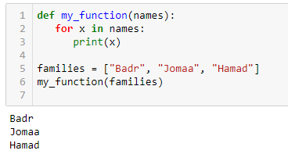
Functions in Python
Passing a List as an Argument
You can send any data types of argument to a function (string, number, list, dictionary etc.), and it will be treated as the same data type inside the function.
def my_function(names):
for x in names:
print(x)
families = [“Badr", “Jomaa", “Hamad"]
my_function(families)

Slide 11
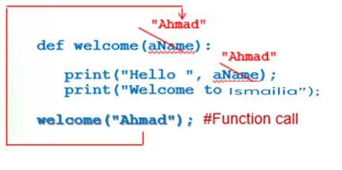
Functions without return
Some functions perform simple procedural tasks (specified in their bodies) but do not return any information when they are called.
Example: Write a function that will display a welcome message to a student with his/her name. Then, use the function in your program.
When the function is called, an actual value for the argument must be used.
For example, when the function call welcome('Ahmad') is executed, the actual string 'Ahmad' replaces the argument aName resulting in the following output:
def welcome(aName):
print("Hello" , aName)
print("Welcome to Ismailia")
welcome("Ahmad") #Function call
-----output-----
Hello Ahmad
Welcome to Ismailia

Slide 12
Functions with return
Some functions provide a value as the result of some calculations made in the function’s body.
Python provides us with the return statement:
return followed by the value it needs to return
In order not to lose the returned value , you need to:
assign it to a variable (for further calculations, if needed)
OR
print it immediately.

Slide 13
Functions with return
Example : Write a function that takes the height and width as arguments, calculates the area of a rectangle, and returns it. Then display the area in the output window. Use the function in your program.
4
6
def recArea(aHeight, aWidth) :
area = aHeight * aWidth
return area
h = eval(input("Enter the height: " ))
w = eval(input("Enter the width: "))
print("Area = ",recArea(h,w)) #Function call inside print()
4
6
-----output-----
Enter the height: 4
Enter the width: 6
Area = 24

Slide 14
Functions with return
Problem: Write a function that accepts two numbers as arguments and returns the sum of these two numbers.
def sum_of_numbers(a, b):
return a + b
num1 = int(input("Enter first number: "))
num2 = int(input("Enter second number: "))
print("Sum of two numbers: ", sum_of_numbers(num1, num2))
The function:

Slide 15
Functions with Multiple return values
So, what if you want to return two variables from a function instead of one? There are a couple of approaches which new programmers take.
Let’s take a look at a simple example:
# example on multiple return values
def profile():
name = input('Enter your name: ‘)
YOB = int(input('Enter your year of birth: '))
age= 2022- YOB
return name, age
name, age = profile()
print('Name: ',name)
print('Age: ',age)
Enter your name: Naji
Enter your year of birth: 1999
Name: Naji
Age: 23
output
The returned values are assigned to variables

Slide 16
Functions with Multiple return values
So, what if you want to return two variables from a function instead of one? There are a couple of approaches which new programmers take.
Let’s take a look at a simple example:
# example on multiple return values
def profile():
name = input('Enter your name: ')
YOB = int(input('Enter your year of birth: '))
age= 2022- YOB
return [name, age]
profile_data = profile()
print('Name: ',profile_data[0])
print('Age: ',profile_data[1])
output
Enter your name: Naji
Enter your year of birth: 1999
Name: Naji
Age: 23
The returned values are now in a list
Capturing the returned values in the list profile_data
Retrieving each item by its index

Slide 17
Functions in Python
Local Variables
A local variable is created inside a function and cannot be accessed by statements that are outside the function. Different functions can have local variables with the same names because the functions cannot see each other's local variables.
Anytime you assign a value to a variable inside a function, you create a local variable.
A local variable belongs to the function in which it is created, and only statements inside that function can access the variable.
def printHello():
aname = input('Enter your name: ')
print("Hello,", aname)
printHello()
Enter your name: Fadi
Hello, Fadi

Slide 18
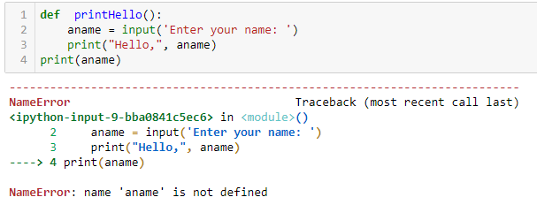
Functions in Python
Local Variables
An error will occur if a statement in one function tries to access a local variable that belongs to another function or any part other than this function.
The statement in line 4 tries to access the aname variable. This results in an error because the aname variable is local to the printHello() function, and statement in line 4 cannot access it.

Slide 19
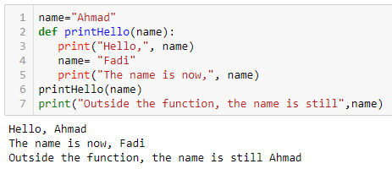
Functions in Python
Making Changes to Parameters
When an argument is passed to a function in Python, the function parameter variable will reference the argument’s value.
However, any changes that are made to the parameter variable will not affect the argument.

Slide 20
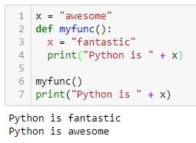
Functions in Python
Global Variables
A global variable can be accessed by any statement in the program file, including the statements in any function.
When a variable is created by an assignment statement that is written outside all the functions in a program file, the variable is global.
name="Ahmad"
def printHello():
print("Hello",name)
printHello()
Hello Ahmad

Slide 21
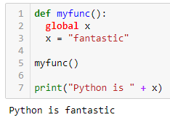
Functions in Python
Global Variables
An additional step is required if you want a statement in a function to assign a value to a global variable. In the function, you must declare the global variable.

Slide 22
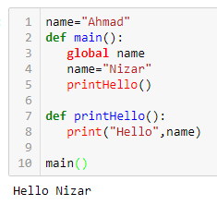
Functions in Python
Global Variables
Also, use the global keyword if you want to change a global variable inside a function.
To change the value of a global variable inside a function, refer to the variable by using the global keyword:
x = "awesome"
def myfunc():
global x
x = "fantastic"
print("Python is " + x)
myfunc()
print("Python is " + x)
output
Python is fantastic
Python is fantastic

Slide 23
Hiding Complexity: Interfaces and Implementations
When a function is called, the resulting value is referred to as the return value of the function.
To use a function, all you need to know are:
the name of the function.
what kind of argument(s) it needs.
what it gives back as a return value.
what other effects calling the function has.
There is a name for the items you need to know: the interface of the function. To use a function, knowing the interface is enough. There’s no need to know what goes on under the bonnet-its implementation.
When the implementation is separated from the interface, thereby hiding some of the complexity, we also say that an abstraction has been created.

Slide 24
The Python Interpreter and Functions
The Python interpreter deals with a program one line after the other, starting with the very first line. A normal program line is executed when the interpreter gets to it. However, functions do receive special treatment, which we examine in this section.
When the Python interpreter encounters a function definition, it reads this definition into memory for later use.
The interpreter only executes the lines of a function definition, when the function is called.

Slide 25
The Python Interpreter and Functions
On those occasions where a function is called, the parameters are initialized with the actual arguments and then the statements in its body are executed.
On encountering the keyword return, Python does two things:
the function stops executing (control is handed back to the point where the function was called originally)
the value of the expression following return is passed back. In other words, the evaluation of the function expression is complete, and the result is the return value of the function.

Slide 26
Using Functions- The Benefits
Replacing duplicate code with a function can make a program shorter and more readable.
A further advantage is that it makes it much easier to modify the code, if needed.
In short, functions can help us write code that:
is shorter and consequently more readable.
is easier to change, making it less likely that errors are introduced.
explicitly mirrors the decomposition of a problem and consequently is easier to understand.

Slide 27
Functions in Python
Storing functions in Modules
As your programs become larger and more complex, the need to organize your code becomes greater. You have already learned that a large and complex program should be divided into functions that each performs a specific task.
As you write more and more functions in a program, you should consider organizing the functions by storing them in modules.
A module is simply a file that contains Python code. When you break a program into modules, each module should contain functions that perform related tasks.
For example, suppose you are writing a billing system. You would store all of the billing receivable functions in their own module, and all the billing payable functions in their own module.
This approach is called modularization, and it makes the program easier to understand, test, and maintain.
Modules also make it easier to reuse the same code in more than one program.
How?

Slide 28
Reusing Code
There is a more elegant way to reuse functions. Instead of copying a function into a new program, you can also put all your functions – say, for drawing figures – into a separate file (with the .py extension).
Let’s call it figure_drawing_functions.py.
At the beginning of your new program, you then simply add from figure_drawing_functions import *.
This has the same effect as placing the function definitions themselves at the beginning of the program. This way, you can create your own library of figure drawing functions.
Important note: You will need to make sure that figure_drawing_functions.py is in the same folder as your new program, otherwise Python won’t be able to find it.

Slide 29
Functions in Python
The math Module
The math module in the Python standard library contains several functions that are useful for performing mathematical operations.
Some math Module functions:
function | Description
ceil(x) | Returns the smallest integer that is greater than or equal to x.
exp(x) | Returns e^{x}
floor(x) | Returns the largest integer that is less than or equal to x.
hypot(x, y) | Returns the length of a hypotenuse that extends from (0, 0) to (x, y).
log(x) | Returns the natural logarithm of x.
log10(x) | Returns the base-10 logarithm of x.
radians(x) | Assuming x is an angle in degrees, the function returns the angle converted to radians.
degrees(x) | Assuming x is an angle in radians, the function returns the angle converted to degrees.
sqrt(x) | Returns the square root of x.

Slide 30
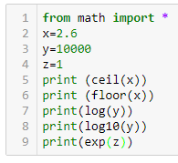
Functions in Python
The math Module
Some math Module functions examples:
3
2
9.210340371976184
4.0
2.718281828459045

Slide 31
Recursive Functions
You have seen instances of functions calling other functions. In a program, the main function might call function A, which then might call function B.
It’s also possible for a function to call itself.
A function that calls itself is known as a recursive function
Recursive function: a function that calls itself
Recursive function must have a way to control the number of times it repeats
Usually involves an if-else statement which defines when the function should return a value and when it should call itself
Depth of recursion: the number of times a function calls itself

Slide 32
Recursion
Like a loop, a recursive function must have some way to control the number of times it repeats.
The code in the below program shows a function called message.
The function receives an argument that specifies the number of times a message should be printed.
# This program has a recursive function
def message(times):
if times>0:
print('This is a recursive function.')
message(times-1)
# Call the message function.
message(5)
The message function in this program contains an if statement that controls the repetition. If the times parameter is greater than zero, the message ‘This is a recursive function’ is displayed, and then the function calls itself again, but with a smaller argument.
The function will stop when times reaches 0.

Slide 33
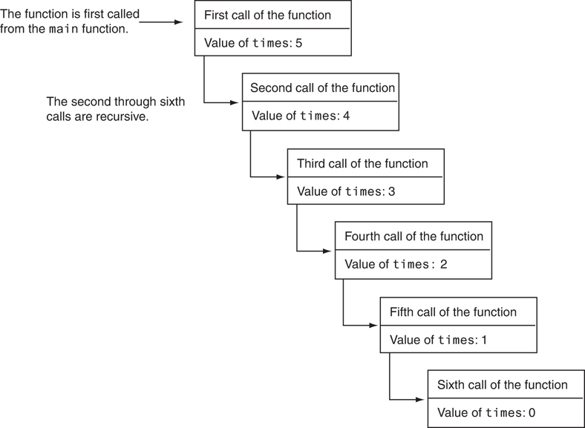
Recursion
The first time the function is called, the times parameter is set to 5. When the function calls itself, a new instance of the times parameter is created, and the value 4 is passed into it. This cycle repeats until finally, zero is passed as an argument to the function.
Figure A: Six calls to the message function

Slide 34
Problem Solving with Recursion
A problem can be solved with recursion if it can be broken down into smaller problems that are identical in structure to the overall problem.
Recursion is a powerful tool for solving repetitive problems
Recursion is not always required to solve a problem
Any problem that can be solved recursively can be solved with a loop
Recursive algorithms usually less efficient than iterative ones
Due to overhead of each function call

Slide 35
Problem Solving with Recursion
Some repetitive problems are more easily solved with recursion than with a loop.
Where a loop might result in faster execution time, the programmer might be able to design a recursive algorithm faster.
In general, a recursive function works as follows:
If the problem can be solved now, without recursion, then the function solves it and returns.
If the problem cannot be solved now, then the function reduces it to a smaller but similar problem and calls itself to solve the smaller problem
In order to apply this approach, first, we identify at least one case in which the problem can be solved without recursion.
This is known as the base case.
Second, we determine a way to solve the problem in all other circumstances using recursion. This is called the recursive case.
In the recursive case, we must always reduce the problem to a smaller version of the original problem.
By reducing the problem with each recursive call, the base case will eventually be reached, and the recursion will stop.

Slide 36
Recursive Programming- Factorial
Let’s take an example from mathematics to examine an application of recursive functions.
In mathematics, n! represents the factorial of a nonnegative number n.
It can be defined by the following rules:
For n = 0, n! = 1
For n > 0, n! = 1 x 2 x 3 x … x n
The above definition lends itself to recursive programming
n = 0 is the base case
n > 0 is the recursive case
n! = n x (n-1)!

Slide 37
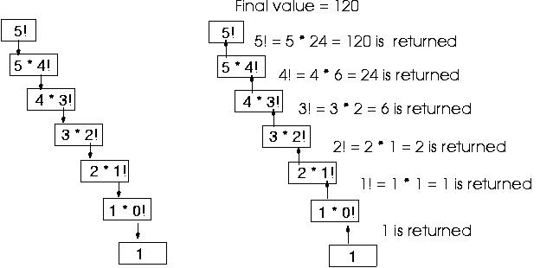
Recursive Programming- Factorial
Factorial can also be defined recursively. Let’s see how it works recursively.
The below figure shows how 5! is calculated recursively including all the recursive steps.

Slide 38
Recursive Programming- Factorial
Now, let’s replace the notation n! with factorial(n), which looks a bit more like computer code, and rewrite these rules as follows:
If n = 0 then factorial(n) = 1
If n > 0 then factorial(n) = n * factorial(n − 1)
def factorial(num):
if num == 0:
return 1
else:
return num * factorial(num-1)
x=eval(input('Enter a nonnegative number'))
print(factorial(x))
Base case
Recursive part
Consider what happens when the definition is applied to the problem of calculating factorial (4):
factorial (4)= 4*factorial (3)
= 4 *3* factorial (2)
= 4*3*2* factorial (1)
= 4*3*2* 1* factorial (0)
= 4*3*2*1*1 = 24

Slide 39
Exercises
Write a program that asks the user to enter a distance in kilometers, then converts that distance to miles. The conversion formula is as follows:
Miles = Kilometers * 0.6214
Python allows you to repeat a string by multiplying it by an integer, e.g. 'Hi' * 3 will give 'HiHiHi’.
Pretend that this feature does not exist, and instead write a function named
repeat that accepts a string and an integer as arguments.
The function should return a string of the original string repeated the
specified number of times, e.g. repeat('Hi', 3) should return 'HiHiHi'.

Slide 40
Ex. 1 Solution
# Global constant for conversion
KILOMETERS_TO_MILES = 0.6214
# main def
def main():
# Local variables
mykilometers = 0.0 # Variable to hold the distance in kilometers
# Get distance in kilometers
mykilometers = float(input("Enter the distance in kilometers: "))
# Print miles
showMiles(mykilometers)
# The showMiles function accepts kilometers as an argument
# and prints the equivalent miles.
def showMiles(kilometers):
#Declare local variables
miles = 0.0
miles = kilometers * KILOMETERS_TO_MILES
print ("The conversion of", format(kilometers, '.2f'), "kilometers")
print ("to miles is", format(miles, '.2f'), "miles.")
# Call the main function.
main()

Slide 41
Ex. 2 Solution
# main function
def main():
# Call the function and print the result for testing.
print(repeat('Hi', 3))
# The repeat function accepts text and multiplier
# and returns a string of text repeated multiplier times.
def repeat(text, multiplier):
# Initialize output to an empty string.
output = ''
# Repeat multiplier times.
output = text * multiplier
# Return output.
return output
# Call the main function.
main()

Slide 42
Exercise 3
Write a program that generates a random number in the range of 1 through 100 and asks the user to guess what the number is.
If the user’s guess is higher than the random number, the program should display “Too high, try again.”
If the user’s guess is lower than the random number, the program should display “Too low, try again.”
If the user guesses the number, the application should congratulate the user and generate a new random number so the game can start over.

Slide 43
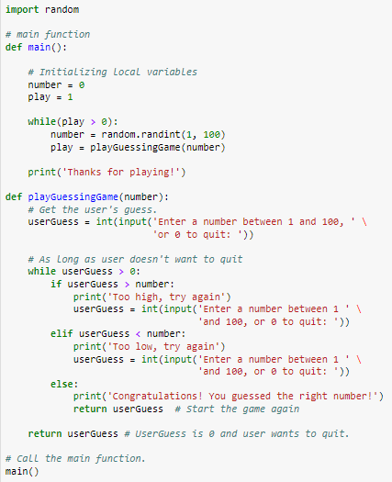
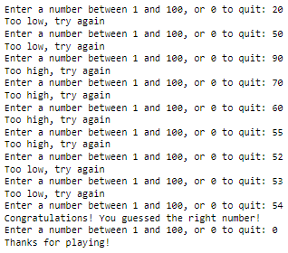
Exercise 3- Solution
Try to modify the program so that the user can have only 5 guesses.
If the user fails to guess after the allowed trials , a proper message should be displayed, and the program terminates.

